Slide 1
Simulation Block Diagram
Atmospheric Model
Ground Model
Wind/
Density/
Pressure/
Temp
Gravity Force/
True Vector
Forces/Moments
Human Controller
Serial Out
Forces/Moments
Aerodynamics/Thrust Model
Dynamics
Visualization
Control Surface
Deflections/Throttle
Velocity Vector/Attitude
True State
Autopilot
Desired States
(Estimated State)
Guidance Laws
Serial In
Estimated State
Navigation/Sensor Model
Guidance Waypoints
Estimated State
Waypoint States
In Arduino
Optional Arduino
Actual Sensors
Optional Controller
Optional Sensors (actual for Arduino only)

Slide 2
Capabilities
Autopilot
Steady level flight
Coordinated Turns
Take-off
Landing
Beginner Mode
Augmented stability (if needed)
Out of range turn around
Anti-stall
Anti-fall out of sky

Slide 3
Navigation
Input
True GPS position/velocity, IMU acceleration/angular rate in body frame, Magnetometer heading
Add noise
Output: estimated states
Use Kalman Filter
Attitude & angular rate from IMU
Position and velocity from GPS and IMU

Slide 4
Generate Base Models
Actuator Base Model
Propulsion Base Model
Create Mass Base Model

Slide 5
Actuator Model
ActuatorTypeBase
Defines one actuator
Define keyboard up and keyboard down directions
Define command location type (keyboard, outside, table)
Outside commands (from serial or autopilot) can be set using setters
Set command
Sets the command from an outside souce
Update
Input a command
Output the position
ActuatorBase
Define multiple actuator types
Define Keyboard terminal to pass into ActuatorTypeBase

Slide 6
Equations

Slide 7
Example Parameters
Variable | Value | Units
I_{xx} | 0.01122
I_{yy} | 0.01122
I_{zz} | 0.02199
Length | 0.23
mass | 1.04
K_{d} (drag coeff=1/2ρA) | 0.82 x 10⁻⁵
K_{H} (torque coeff) | 1.40 x 10⁻⁷
K_{T} (thrust coeff) | 0.00215
0.00215*0.23/0.01122=0.0004945/0.01122=0.044->wn = 0.22

Slide 8
Rotations and Definitions
LL to Body
[cos(θ) 0 –sin(θ) ]
R_{B_NED}= [sin(θ)sin(Φ) cos(Φ) cos(θ)sin(Φ)]
[sin(θ)cos(Φ) –sin(Φ) cos(θ)cos(Φ)]
Body to LL
[cos(θ) sin(θ)sin(Φ) sin(θ)cos(Φ)]
R_{NED_B}= [ 0 cos(Φ) –sin(Φ) ]
[–sin(θ) cos(θ)sin(Φ) cos(θ)cos(Φ)]
Body Rate to Euler Rate
θ = L ω
[dΦ/dt] [1 sin(Φ)tan(θ) cos(Φ)tan(θ)] [p]
[dθ/dt ] = [ 0 cos(Φ) –sin(Φ) ] [q]
[dΨ/dt] [0 sin(Φ)sec(θ) cos(Φ)sec(θ)] [r]

Slide 9
Forces
Thrust
ΣF_{LL}=R_{LL_B}T_{B} + mg
T_{B}=0i + 0j + -T_{B}k
[cos(θ) sin(θ)sin(Φ) sin(θ)cos(Φ) ] [ 0 ] [0]
ΣF_{LL}= [ 0 cos(Φ) –sin(Φ) ] [ 0 ] + m [0]
[–sin(θ) cos(θ)sin(Φ) cos(θ)cos(Φ)] [-T_{B}] [g]
T_{B}=K_{T}(ω₁²+ω₂²⁺ω₃²⁺ω₄²)
Gravity
g=0i + 0j + gk
ΣF_{LL}= ma_{LL}= -sin(θ)cos(Φ) T_{B}i + sin(Φ)T_{B}j + mg-cos(θ)cos(Φ)T_{B}k
ΣF_{LLx} = -sin(θ)cos(Φ) K_{T}(ω₁²+ω₂²⁺ω₃²⁺ω₄²)
ΣF_{LLy} = sin(Φ) K_{T}(ω₁²+ω₂²⁺ω₃²⁺ω₄²)
ΣF_{LLz} = mg - cos(θ)cos(Φ) K_{T}(ω₁²+ω₂²⁺ω₃²⁺ω₄²)
dVLL_{x}/dt = -sin(θ)cos(Φ) K_{T}(ω₁²+ω₂²⁺ω₃²⁺ω₄²)
dVLL_{y}/dt = sin(Φ) K_{T}(ω₁²+ω₂²⁺ω₃²⁺ω₄²)
dVLL_{z}/dt = mg - cos(θ)cos(Φ) K_{T}(ω₁²+ω₂²⁺ω₃²⁺ω₄²)

Slide 10
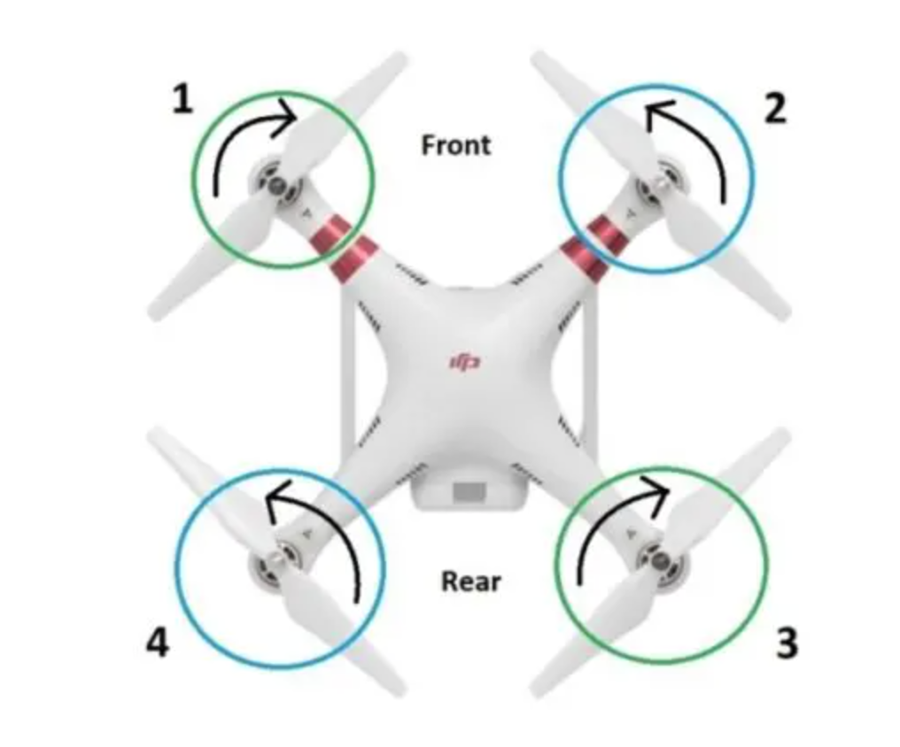
Moments
Rotor Moment
H_{i}=K_{H} ω_{i}²
ΣM_{B}= [(T_{B1}+T_{B4})L - (T_{B2}+T_{B3})L]i +[(T_{B1}+T_{B2})L - (T_{B3}+T_{B4})L]j + [(H₁+H₃) – (H₂+H₄)]k
ΣM_{Bx}= K_{T}[(ω₁² +ω₄²) - (ω₂² +ω₃²)]L
ΣM_{By}= K_{T}[(ω₁² +ω₂²) - (ω₃² +ω₄²)]L
ΣM_{Bz}= K_{H}[(ω₁² +ω₃²) - (ω₂² +ω₄²)]

Slide 11
Control Inputs
dT – set throttle command
da – roll command
de – pitch command
dr – yaw command
Rotor | Roll Sign | Pitch Sign | Yaw Sign
1 | + | + | +
2 | - | + | -
3 | - | - | +
4 | + | - | -
dT = ω₁² + ω₂² + ω₃² + ω₄²
da = (ω₁² + ω₄²) – (ω₂² + ω₃²)
de = (ω₁² + ω₂²) – (ω₃² + ω₄²)
dr = (ω₁² + ω₃²) – (ω₂² + ω₄²)
dT = ω₁² + ω₂² + ω₃² + ω₄²
da = ω₁² - ω₂² - ω₃² + ω₄²
de = ω₁² + ω₂² - ω₃² - ω₄²
dr = ω₁² - ω₂² + ω₃² - ω₄²
[1 1 1 1] [ω₁²] [dT]
[1 -1 -1 1] [ω₂²] = [da]
[1 1 -1 -1] [ω₃²] [de]
[1 -1 1 -1] [ω₄²] [dr]

Slide 12
Control Inputs to Rotor Inputs – Way 1
dT = ω₁² + ω₂² + ω₃² + ω₄²
da = (ω₁² + ω₄²) – (ω₂² + ω₃²)
de = (ω₁² + ω₂²) – (ω₃² + ω₄²)
dr = (ω₁² + ω₃²) – (ω₂² + ω₄²)
dT = ω₁² + ω₂² + ω₃² + ω₄²
da = ω₁² - ω₂² - ω₃² + ω₄²
de = ω₁² + ω₂² - ω₃² - ω₄²
dr = ω₁² - ω₂² + ω₃² - ω₄²
Known: dT, da, de, dr
Unkwon: ω₁², ω₂², ω₃², ω₄²
->
->
[1 1 1 1 ] [ω₁²] [dT]
[1 -1 -1 1] [ω₂²] = [da]
[1 1 -1 -1] [ω₃²] [de]
[1 -1 1 -1] [ω₄²] [dr]
[1/4 1/4 1/4 1/4 ] [dT] [ω₁²]
[1/4 -1/4 1/4 -1/4] [da] = [ω₂²]
[1/4 -1/4 -1/4 1/4] [de] [ω₃²]
[1/4 1/4 -1/4 -1/4] [dr] [ω₄²]
ω₁² = (dT+da+de+dr)/4
ω₂² = (dT-da+de-dr)/4
ω₃² = (dT-da-de+dr)/4
ω₄² = (dT+da-de-dr)/4

Slide 13
Control Inputs to Rotor Inputs – Way 2
dT = ω₁² + ω₂² + ω₃² + ω₄²
da = (ω₁² + ω₄²) – (ω₂² + ω₃²)
de = (ω₁² + ω₂²) – (ω₃² + ω₄²)
dr = (ω₁² + ω₃²) – (ω₂² + ω₄²)
dT = ω₁² + ω₂² + ω₃² + ω₄²
da = ω₁² - ω₂² - ω₃² + ω₄²
de = ω₁² + ω₂² - ω₃² - ω₄²
dr = ω₁² - ω₂² + ω₃² - ω₄²
Known: dT, da, de, dr
Unkwon: ω₁², ω₂², ω₃², ω₄²
->
->
dT+da+de+dr = 4ω₁² -> ω₁² = (dT+da+de+dr )/4 -> dT+da+de+dr ≥ 0
dT+da-de-dr = 4ω₄² -> ω₄² = (dT+da-de-dr )/4 -> dT+da ≥ de+dr
dT-da-de+dr = 4ω₃² -> ω₃² = (dT-da-de+dr )/4 -> dT+dr ≥ da+de
dT-da+de-dr = 4ω₂² -> ω₂² = (dT-da+de-dr )/4 -> dT+de ≥ da+dr

Slide 14
Control Input Contraints
da = de = dr = x dT
dT+da+de+dr ≥ 0
dT+da-de-dr ≥ 0
dT-da-de+dr ≥ 0
dT-da+de-de ≥ 0
dT + 3x dT ≥ 0
dT - 2x dT ≥ 0
dT - 2x dT ≥ 0
dT - 2x dT ≥ 0
1 ≥-3x
1 ≥ 2x
x ≥-1/3
x ≤ 1/2
-1/3 dT ≤ da = de = dr ≤ 1/2dT
dMax = 4ω_{max}²
dT+da+de+dr ≤ 4ω_{max}²
dT+da-de-dr ≤ 4ω_{max}²
dT-da-de+dr ≤ 4ω_{max}²
dT-da+de-de ≤ 4ω_{max}²
dT + 3x dT ≤ dMax
dT - 2x dT ≤ dMax
dT - 2x dT ≤ dMax
dT - 2x dT ≤ dMax
dT + 3x dT ≤ dMax
dT - 2x dT ≤ dMax
x ≤ (dMax – dT)/(3dT)
x ≥ (dT – dMax)/(2dT)
(dT – dMax)/(2dT) dT ≤ da = de = dr ≤ (dMax – dT)/(3dT) dT
-(dMax - dT )/2 ≤ da = de = dr ≤ (dMax – dT)/3

Slide 15
Control Input Contraints
da < 0.5*dT
da > -1/3*dT
min dT when roll, pitch, or yaw is desired. Greater of
2*dmax
-3*dmax
At all times dTmin < dTo, and dTmax > dTo
Must be less than
dTo to retain velocity control

Slide 16
Throttle to RPM to Throttle
PWM In | dT | ω = sqrt(dT/4) | RPM | PWM = (ω – b)/m | PWM Cmd
1000 | 0 |  | 0 |  | 1000
1100 |  |  |  |  | 1100
1200 | 4*ω_{min}² | ω = sqrt(4*ω_{min}²/4) | ω_{min} |  | 1200
2000 | 4*ω_{max}² |  | ω_{max} |  | 2000

Slide 17
Throttle to RPM
Throttle % | PWM | RPM | Comment
0 | 1,000 | 0
minThrottle>0 | minPWM>1,000 | minRPM | No RPM below 10% throttle
maxThrottle | maxPWM=2,000 | maxRPM | Linear to max RPM
if (Throttle < minThrottle) {
RPM = 0;
}
else {
RPM = m*Throttle + b;
}

Slide 18
Controller Inputs to PWM
ω₁² = (dT+da+de+dr)/4
ω₂² = (dT-da+de-dr)/4
ω₃² = (dT-da-de+dr)/4
ω₄² = (dT+da-de-dr)/4
ω_{i}=m*Throttle_{i} + b
if (ω_{i} < rpmMin) {
Throttle_{i} = minPWM
}
else {
Throttle_{i} = (sqrt(ω_{i}²)-b)/m
}

Slide 19
Control Architecture
Control Roll, Pitch, YawRate inner loop
Control VLL_{x}, VLL_{y}, VLL_{z} outer loop
VLL_{xcmd} -> Pitch_{cmd} -> de
VLL_{ycmd} -> Roll_{cmd} -> da
VLL_{zcmd} -> dT
YawRate_{cmd}->dr
Inner loop 4x faster than outer loop

Slide 20
Forces, Moments, and Control Inputs
ΣF_{LLx} = m(dVLL_{x}/dt) = -sin(θ)cos(Φ) K_{T}dT
ΣF_{LLy} = m(dVLL_{y}/dt) = sin(Φ) K_{T}dT
ΣF_{LLz} = m(dVLL_{z}/dt) = mg - cos(θ)cos(Φ) K_{T}dT
ΣM_{Bx}= I_{xx}(dp/dt)+qr(I_{zz}-I_{yy}) = K_{T}Lda
ΣM_{By}= I_{yy}(dq/dt)+pr(I_{xx}-I_{zz}) = K_{T}Lde
ΣM_{Bz}= I_{zz}(dr/dt)+pq(I_{yy}-I_{xx}) = K_{H}dr
dVLL_{x}/dt = -1/m*sin(θ)cos(Φ) K_{T}dT
dVLL_{y}/dt = 1/m*sin(Φ) K_{T}dT
dVLL_{z}/dt = g – 1/m*cos(θ)cos(Φ) K_{T}dT
dp/dt = (K_{T}L/I_{xx}) da - qr(I_{zz}-I_{yy})/I_{xx}
dq/dt = (K_{T}L/I_{yy}) de - pr(I_{xx}-I_{zz}) /I_{yy}
dr/dt = (K_{H}/I_{zz}) dr - pq(I_{yy}-I_{xx})/I_{zz}
[dΦ/dt] [1 sin(Φ)tan(θ) cos(Φ)tan(θ)] [p]
[dθ/dt ] = [ 0 cos(Φ) –sin(Φ) ] [q]
[dΨ/dt] [0 sin(Φ)sec(θ) cos(Φ)sec(θ)] [r]

Slide 21
Linearization Assumptions
x = [V_{LLx}, V_{LLy}, V_{LLz}, θ, Φ, p, q, r]
u = [dT, da, de, dr]
Linearize about hover
x = [0, 0, 0, 0, 0, 0, 0, 0]
u = [mg/K_{T}, 0, 0, 0]
dT=mg/K_{T} is the dT for constant altitude

Slide 22
Linearization
dVLL_{x}/dt = -(K_{T}dT_{o}/m)θ
dVLL_{y}/dt = (K_{T}dT_{o}/m)Φ
dVLL_{z}/dt = -(K_{T}/m)ΔdT
dΦ/dt = p
dθ/dt = q
dψ/dt = r
dp/dt = d²Φ/dt² = K_{T}L/I_{xx}da
dq/dt = d²θ/dt² = K_{T}L/I_{yy}de
dr/dr =d²ψ/dt² = K_{H}/I_{zz} dr

Slide 23
Vx Control Loops
dVLL_{x}/dt = (-K_{T}dT_{o}/m)θ
d²θ/dt² = K_{T}L/I_{yy}de
sVLL_{x}(s) = -K_{vx}θ(s)
s²θ(s) = K_{θ}de(s)
P_{vx}(s) =VLL_{x}(s)/θ(s) = -K_{vx}/s
P_{θ}(s) = θ(s)/de(s) = K_{θ}/s²
K_{vx} = K_{T}dT_{o}/m
K_{θ} = K_{T}L/I_{yy}
P_{θ}(s)
P_{vx}(s)
Vx_{e}
θ_{cmd}
θ_{e}
de
θ
Vx
Vx_{cmd}
+
-
C_{θ}(s)
+
-
C_{vx}(s)
K_{θ}/s²
-K_{vx}/s
Vx_{e}
θ_{cmd}
θ
Vx
Vx_{cmd}
+
-
C_{θ}(s)
H_{θ}(s)
-K_{vx}/s

Slide 24
Vx Inner Pitch Loop
θ_{cmd}
θ_{e}
de
θ
+
-
C_{vx}(s)
K_{θ}/s²
G(s) = θ(s)/θ_{e}(s) = C_{vx}(s) P_{θ}(s)
PD Controller
de(s) = kp*θ_{e}(s)+s*kd*θ_{e}(s)
C_{vx}(s) = de(s)/θ_{e}(s) = kp+s*kd
G(s) =C_{vx}(s)P_{θ}(s) = k_{θ}(kp+s*kd)/s²
H(s) = θ(s)/θ_{cmd}(s) = G(s)/(1+G(s)) = (k_{θ}*kd*s+k_{θ}*kp) / (s²+k_{θ}*kd*s+k_{θ}*kp)
Steady State Error
θ_{e}(s) = θ_{cmd}(s)/(1+G(s)) = s²θ_{cmd}(s)/(s²+k_{θ}kds+k_{θ}kp)
Steady state error = 0 for impulse, step, and ramp inputs

Slide 25
Vx Inner Loop Response
H(s) = θ(s)/θ_{cmd}(s) = G(s)/(1+G(s)) = (k_{θ}*kd*s+k_{θ}*kp) / (s²+k_{θ}*kd*s+k_{θ}*kp)
wn = 80 * 2 * pi = 502.4
zeta = 1
s²+k_{θ}*kd*s+k_{θ}*kp = s² + 2*zeta*wn*s + wn²
kp = wn²/k_{θ} = 148,473,976
kd = 2*zeta*wn/k_{θ} = 591,058.8
K_{θ} = K_{T}L/I_{yy}
K_{T} = Tmax/(maxrpm²) = 4.22/(rad(6440²)) = 0.000334
L = 0.1
I_{yy} = 0.0196
K_{θ} = 0.0017

Slide 26
Vy Control Loops

Slide 27
Vz Control Loop
dVLL_{z}/dt = (-K_{T}/m)ΔdT
sVLL_{z}(s) = -K_{vz}ΔdT(s)
P_{vz}(s) =VLL_{z}(s)/ΔdT (s) = -K_{vz}/s
K_{vz} = K_{T}/m
Vz_{e}
ΔdT_{cmd}
Vz_{cmd}
+
-
Vz
C_{T}(s)
-K_{vz}/s
P Controller
ΔdT(s) = kp*Vz_{e}(s) -> C_{vz}(s) = ΔdT(s)/Vz_{e} (s) = kp
G(s) =C_{vz}(s)P_{T}(s) = -kpK_{vz}/s
H(s) = Vz(s)/Vz_{cmd}(s) = G(s)/(1+G(s)) = (-kpK_{vz}) / (s-kpK_{vz})
Steady State Error
Vz_{e}(s) = Vz_{cmd}(s)/(1+G(s)) = sVz_{cmd}(s)/(s-kpK_{vz})
Steady state error = 0 for impulse and step inputs, -1/kpK_{vz} error for ramp input

Slide 28
Yaw Rate Control Loop
dVLL_{z}/dt = (-K_{T}/m)ΔdT
sVLL_{z}(s) = -K_{vz}ΔdT(s)
P_{vz}(s) =VLL_{z}(s)/ΔdT (s) = -K_{vz}/s
K_{vz} = K_{T}/m
Vz_{e}
ΔdT_{cmd}
Vz_{cmd}
+
-
Vz
C_{T}(s)
-K_{vz}/s
P Controller
ΔdT(s) = kp*Vz_{e}(s) -> C_{vz}(s) = ΔdT(s)/Vz_{e} (s) = kp
G(s) =C_{vz}(s)P_{T}(s) = -kpK_{vz}/s
H(s) = Vz(s)/Vz_{cmd}(s) = G(s)/(1+G(s)) = (-kpK_{vz}) / (s-kpK_{vz})
Steady State Error
Vz_{e}(s) = Vz_{cmd}(s)/(1+G(s)) = sVz_{cmd}(s)/(s-kpK_{vz})
Steady state error = 0 for impulse and step inputs, -1/kpK_{vz} error for ramp input

Slide 29
Yaw Rate Loop Response
H(s) = r(s)/r_{cmd}(s) = G(s)/(1+G(s)) = (kp*kr)/(s+kp*kr)
wn = 1500 * 2 * pi = 9,420
wn = kp*kr
kp = wn/kr = 248,680,042
kr = K_{H}/I_{zz}
K_{H} = Q*K_{T} = 0.003*0.000334 = 0.000001
I_{zz}= 0.0264
kr = 0.00003788

Slide 30
Kalman Filter

